Slide 1
Unit 1, Semester 2: Yarn Painting
Art with Ms. Gay
Spring 2017

Slide 2
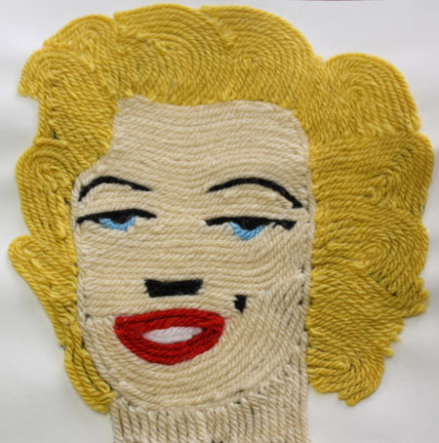
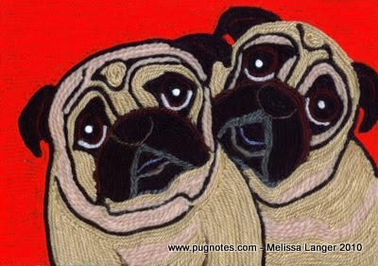
Yarn Painting Examples

Slide 3
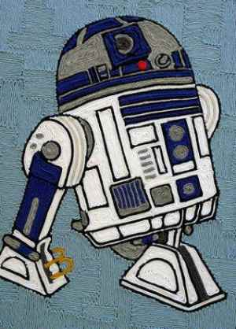
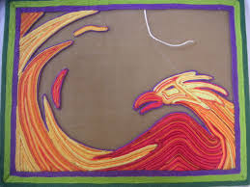
Yarn Painting Examples

Slide 4
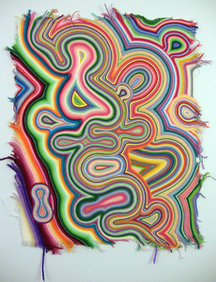
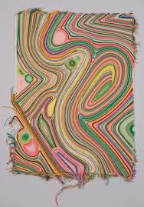
Yarn Painting Examples

Slide 5
Yarn Painting
What is yarn painting?
Creation of an image using only yarn.
What are the steps?
Draw your image on regular drawing paper (will be provided)
Transfer your image to a piece of cardboard—we will review how to transfer the drawing to the cardboard
Use white glue to adhere the yarn to the cardboard

Slide 6
How to Transfer Your Drawing
Turn your paper over to the back.
Using a dark crayon, color the entire back of your drawing using a LOT of pressure (see examples)
Turn the drawing back over to the front and place over the cardboard; tape in place
Use a pencil and draw over the original lines, this time using a lot of pressure
Remove your drawing—the drawing should have transferred onto the cardboard, and will have left a crayon imprint.

Slide 7
Due Dates
Must complete one rough draft in sketchbook (use about ½ paper size)
Complete drawing to be transferred on final paper by Wednesday, 1/11/17
Final Project due at the end of the period on Thursday, 1/19/17
Sketchbook #1 due at the beginning of the period on Thursday, 1/19/17

