Slide 1
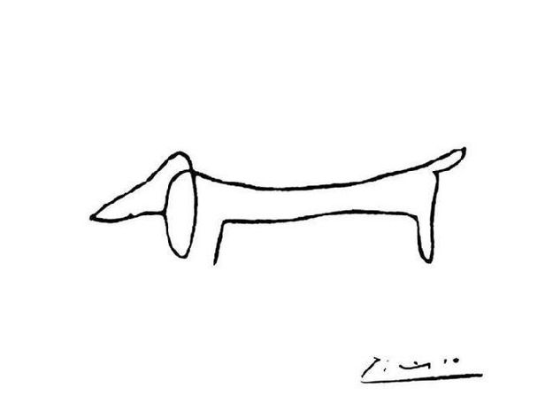
Unit 2, Part 2: Contour Line
Beginning Art with Ms. Gay
Fall 2016

Slide 2
Unit 2, Part 2 Project
For this project, you will use only contour line (no shading) to create a Sahuaro and/or Tucson themed coloring book page.
Your project should be completely original. You may use the internet to search for some ideas and to get reference photos to help you draw. (NO TRACING!)
You do NOT need to use continuous/blind contour line on the project.
This project is due on Thursday, September 1st at the beginning of the period.

Slide 3
Unit 2, Part 2 Project
You will need to plan your project before you start.
In your sketchbook, you will need to plan 2 different images.
Draw quick sketches of each and show me when you are finished in order to begin on your project using the “final” paper.
Rough sketches should be presented no later than Wednesday, August 24th.
What makes a good coloring page?
Thick vs. thin lines
Large areas to be colored vs. small, detailed areas
Looks like it can be colored in an interesting way (for example, the coloring artist can add their own details and interpret color schemes to suit their tastes)
Patterns
Simple, recognizable objects
Good composition

Slide 4
Unit 2, Part 2 Project
What kinds of things do you think of when you hear “Sahuaro” or “Tucson” themed?
Cougars Cacti
Paw prints Sunsets
Sports Mountains
Friends Eegee’s
Teachers Special Tucson-specific places

Slide 5
Unit 2, Part 2 Sketchbook Assignment (#2)
In your sketchbook, you will need to complete contour drawings of any object(s) of your choice. You will need:
3 regular contour drawings of any object of your choice; draw for 1 minute, 2 minutes, then 5 minutes
3 continuous contour drawings of any object of your choice, same time limits as the regular contour drawings
3 blind contour drawings done at the same time limits as the regular contour drawings
SB #2 is due at the beginning of the period on Thursday, August 25th.

Slide 6
