Slide 1
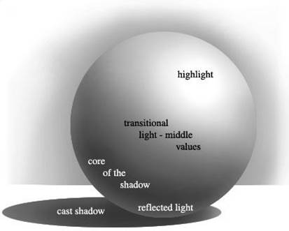
Unit 2: Shape & Form Definitions
Art with Ms. Gay
Intermediate & Beginning Art
Fall 2015
Write down these definitions in your sketchbook.
Shape: organic or geometric shapes are formed when lines meet; shapes are two dimensional, in that they have height and width.
Form: three-dimensional objects that have height, width, and depth.
Implied form: a shape on a two-dimensional surface that appears to be three-dimensional.
Copy this schematic in your sketchbook.

