Slide 1
Unit 1: Color Theory Using Color Pencil Techniques
Beginning Art with Ms. Gay
Fall 2016

Slide 2
Unit 1 Introduction
Color Theory: Color Wheel Worksheet
Review color pencil techniques.
Varying pressure
Layering
Blending
Hatching/cross-hatching
Burnishing
Coloring practice page
Introduce unit project

Slide 3
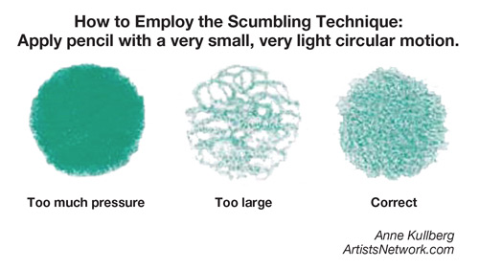
How to Color Properly
Do not use lines to color in sections…use scumbling!

Slide 4
Color Pencil Techniques
Varying pressure
Done exactly as the name states: use less pressure for lighter color, more pressure for deeper color

Slide 5
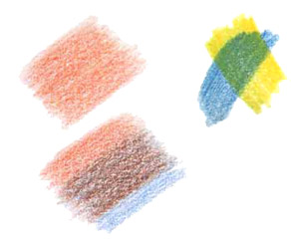
Color Pencil Techniques
Layering
Can layer the same color to create more depth, or layer multiple colors to create different colors/effects

Slide 6
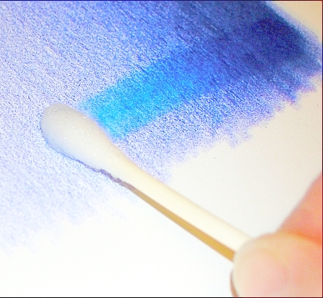
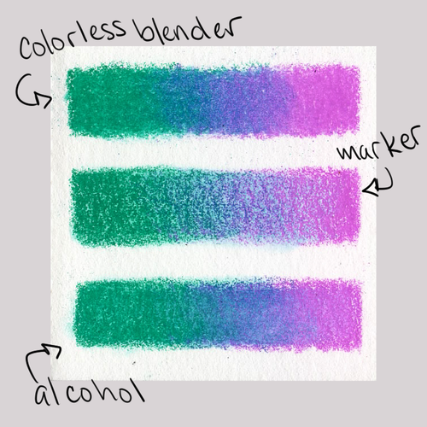
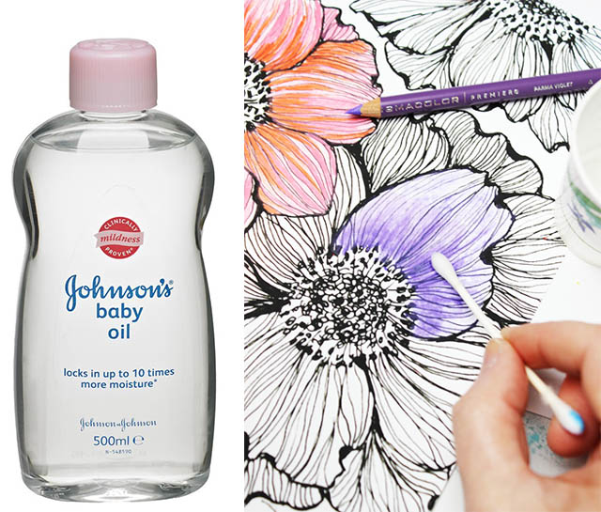
Color Pencil Techniques
Blending
Use a colorless blender pencil, a white colored pencil, rubbing alcohol, or baby oil to smooth rough lines and blend colors together

Slide 7
Color Pencil Techniques
Hatching/Cross-hatching
Hatching: make lines going in the same direction (parallel) to indicate shadows/color change
Cross-hatching: make lines overlapping each other in different directions (perpendicular) to indicate shading or color change

Slide 8
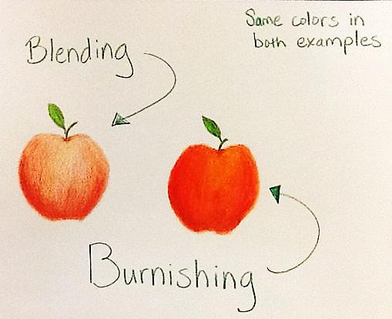
Color Pencil Techniques
Burnishing
Layer color(s), then apply heavy pressure to create a polished or glazed look
Can use a white color pencil (or another light color pencil) or object such as a spoon

Slide 9
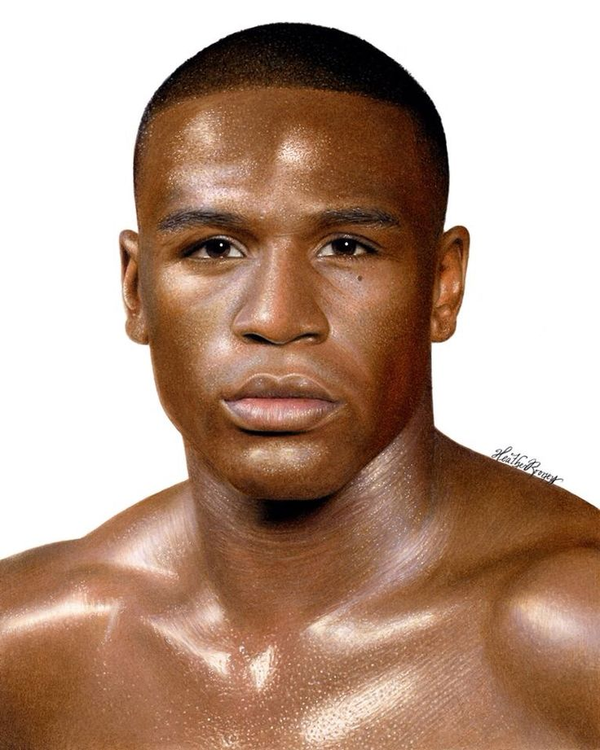
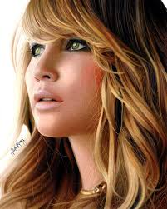
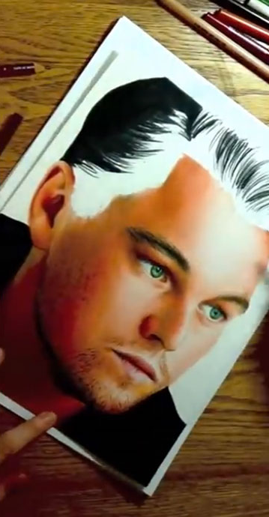
Some Awesome Color Pencil Artists
Heather Rooney: self-taught, portrait artist

Slide 10
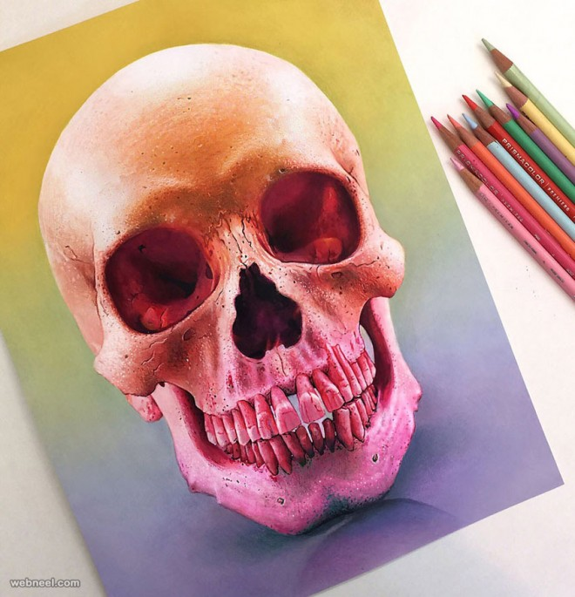
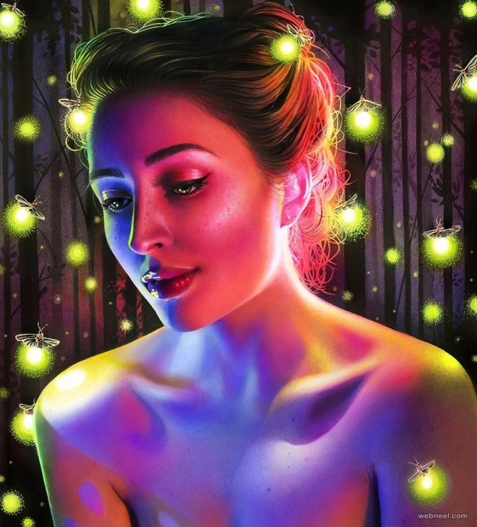
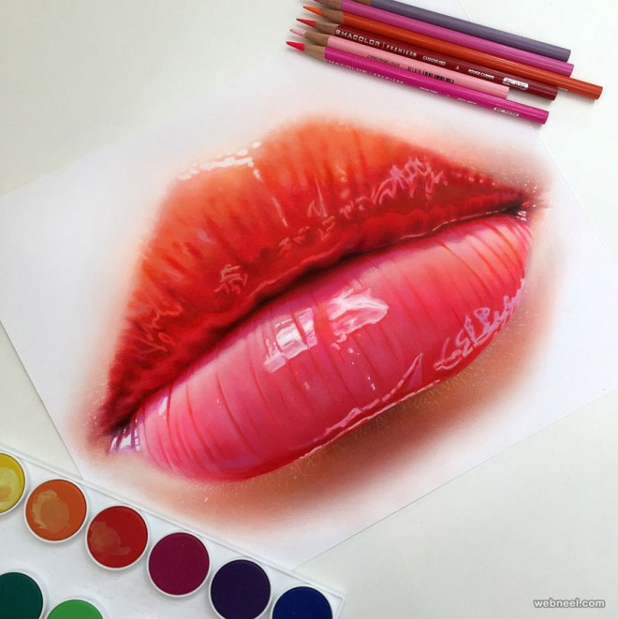
Some Awesome Color Pencil Artists
Morgan Davidson: graduate or Ringling College; nature/fashion emphasis

Slide 11
Unit 1 Project
For this project, you will use all five color pencil techniques you learned in class to complete a coloring book page.
You may bring in your own coloring page (from a coloring book or printed from the internet) or you can have one of mine.
If there is one you want from one of my coloring books that hasn’t been copied yet, please ask me to get a copy for you—it takes 1-2 days to get copies made.

Slide 12
Unit 1 Project Rubric
Use of all color pencil techniques, 1 point per technique = 0-5 points possible
Effort = 0-5 points possible, based on observed effort given during class time and as is evidenced by the final artwork
5 = A
4 = B
3 = C
2 = D
0-1 = F
Project total is 10 points

