Slide 1
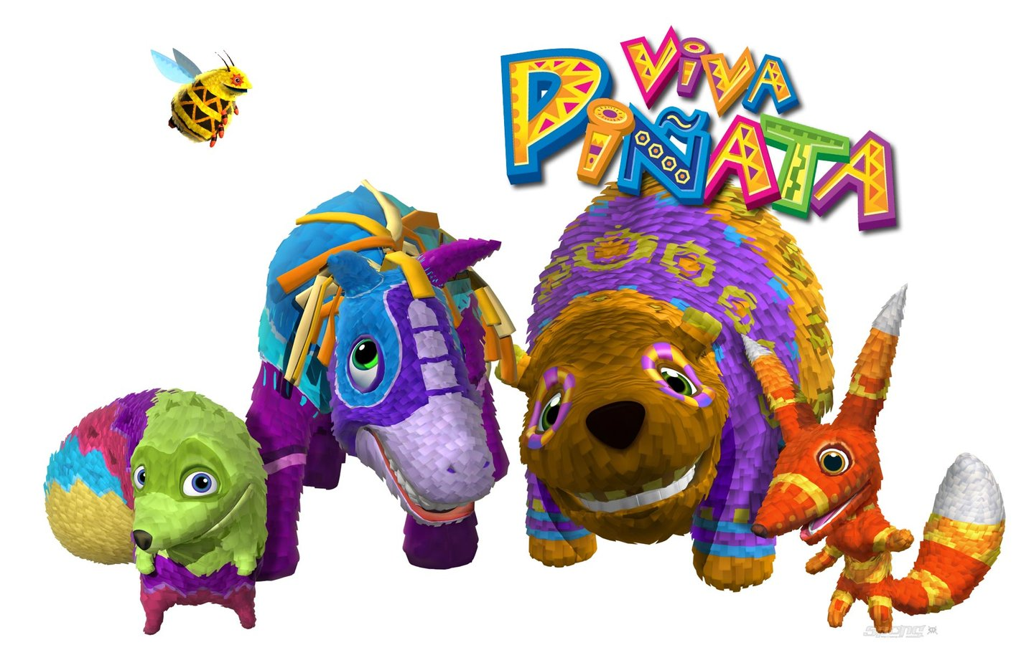
Art with Ms. Gay

Slide 2
Guidelines for Piñatas
You will be creating your own piñata. You may work alone or with a group (no more than 4 people per group).
You can make anything you want, but do not make just a “cube” or “ball” piñata (lame)
Your design cannot be taller or longer than 1 foot on all sides.
If you want to be able to put candy or prizes inside of your piñata, you must make a flap that can open and close.
You will build your design out of cardboard, then papier mache over the cardboard to create the form. The final step will be to either paint your piñata or use tissue paper to make a traditional piñata.

Slide 3
Unit Schedule
Monday, April 25th: plan & design using worksheet; start building with cardboard if you have time
Tuesday, April 26th: build piñata design out of cardboard
Wednesday & Thursday: papier mache. I will provide a special papier mache paste. However, you may also use flour and glue.
Monday, May 2nd: papier mache (done in layers)
Tuesday-Thursday: cover in tissue paper/paint for color
PROJECT DUE: May 5th

Slide 4
Agenda for Today
Day 1: plan and design
Will use worksheet to plan
Write down all group member names (no more than four people in one group)
Tell me what materials you need (examples: how much cardboard, rulers, what color tissue paper?)
Draw schematics showing your design from all sides

Slide 5
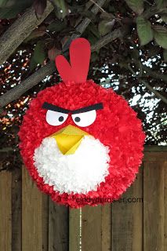
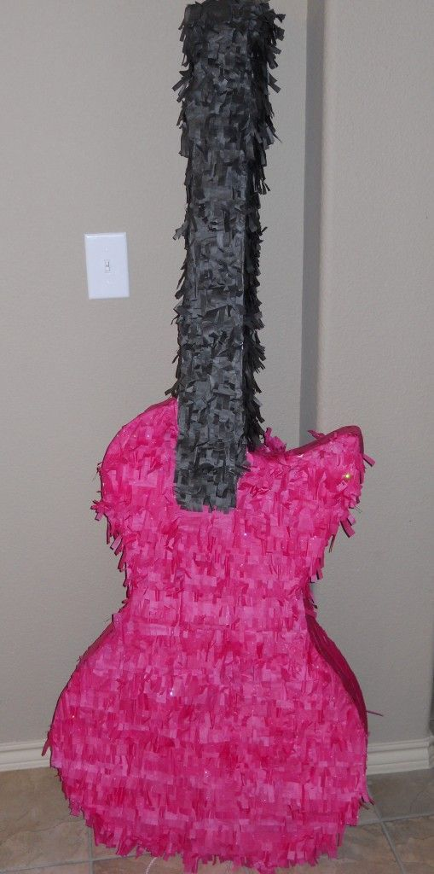
Example Piñatas

Slide 6
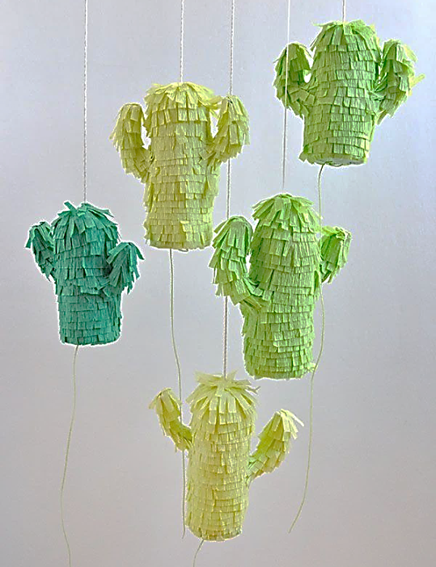
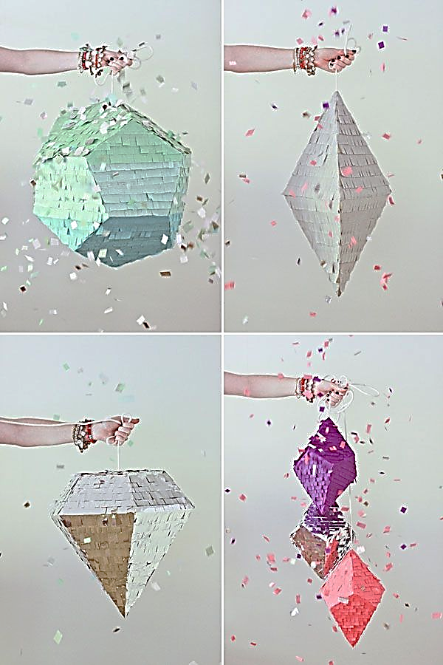
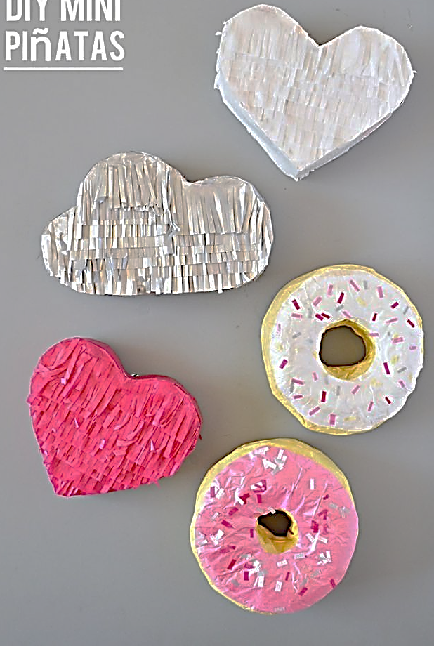
Example Piñatas

Slide 7
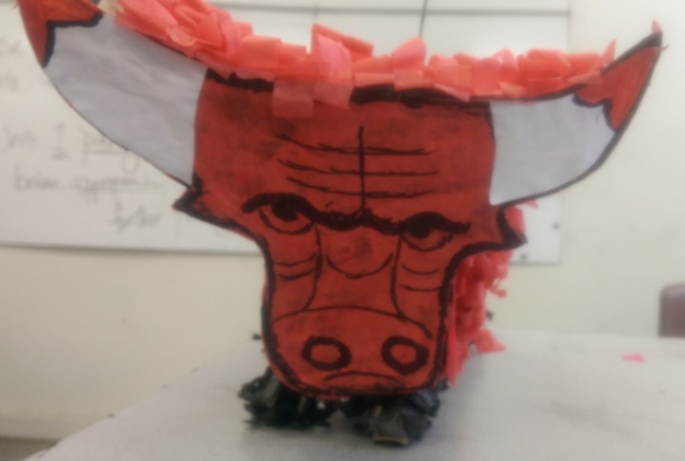
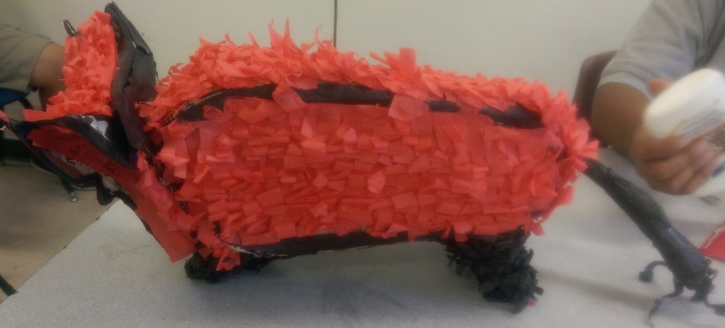
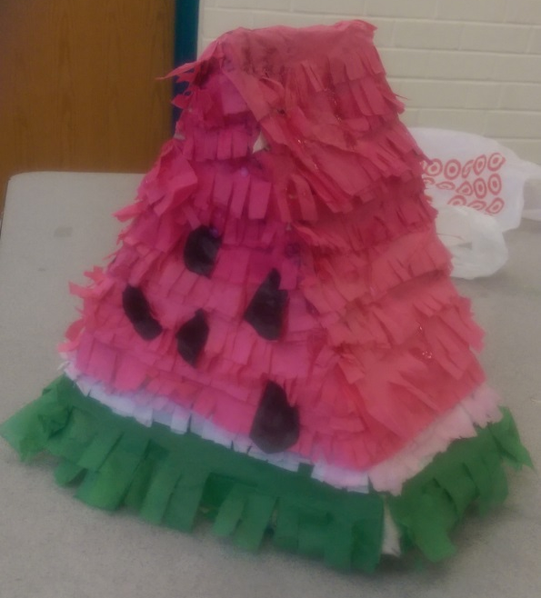
Example Piñatas

Slide 8
Example Piñatas

