Slide 1
Linocut Printmaking Safety Lecture
Art with Ms. Gay
Spring 2016

Slide 2
Safety with Sharp Tools
The blade should always be pointed away from your body and opposite hand.
Push the blade forward, not down (this will create holes in your linoleum).
The handle does not require a lot of pressure to remove the linoleum.
To make circular cuts, rotate the linoleum around the tool—DO NOT try to force your hand to follow the shape.
The lino tools are NOT to be used for any other purpose than to carve into your linoleum.
Any abuse of the carving tools will result in losing privileges to use the tools, and a zero grade for the project. Depending on the circumstances, you may be removed from class for the entirety of the project.

Slide 3
Common Sense Expectations
Clean up your rubber scraps after you’re done cutting for the day. Everyone will be responsible for keeping the room clean during this unit.
If something breaks (blade, handle, etc.) notify Ms. Gay.
You are not allowed to keep linocutting tools in your cubbies or with you—they must be returned to the supply table at the end of the period.
DO NOT RUN, THROW, OR USE THE LINO TOOLS UNSAFELY. When carrying the tools, always point the blade down.

Slide 4
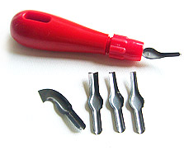
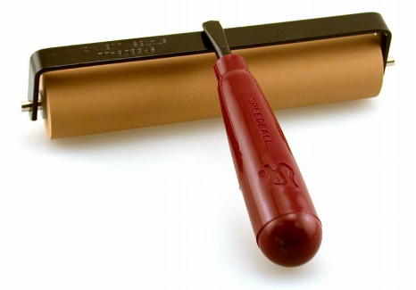
Name that tool!
Lino Cutter
Handle
Brayer
Blades

