Slide 1
Genius Hour: Spring 2017
Beginning Art
Ms. Gay

Slide 2
Mixed Media Art Project
On a canvas panel, you will design an image based on a single word or name. For example, “love,” “peace,” or use your own name, a name of a friend, family member, dog, etc.
This is a mixed media project, which means you will be incorporating several different art styles and media into the finished product.
Each Friday you will be expected to work on this project by adding another “component.”
There are ten components that you must include. I will provide you with a checklist and timeline of working through project.

Slide 3
Components
This project requires including each of the following components in relation to your chosen word in order to receive full points:
Newspaper
A background
Text (separate from the newspaper)
A portrait (open media—can be drawn, painted, a photograph, printed, cut from a magazine, etc.)
An object (same, any media)
A drawn component
A painted component, done in acrylic paint
Free choice—any media (can add things in, like decoupage—think flowers, glitter, feathers, beads, etc.)
A photograph that you took (must be taken during our quarter, not one from the past)
An art history reference (use a style, image, etc.)
Some of these have overlap. For example, a background means covering the whole canvas panel, but this could include using the newspaper as part of the background.
You will be provided with a Component Checklist. You are expected to keep this form throughout the quarter, have it available for graded progress checks, and then submit it as part of your final project in March.

Slide 4
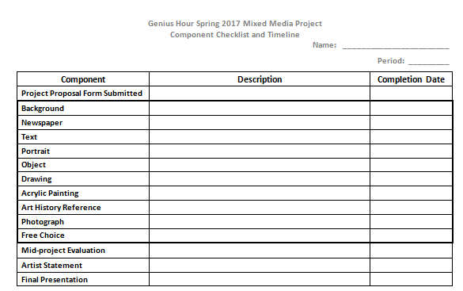
Component Checklist

Slide 5
Genius Hour Proposal
First Genius Hour graded assignment: complete the Proposal form (will be provided)
Proposal form only asks about your chosen word, what each component will look like, and a rough sketch. (It’s very easy to fill out!)
Due by the end of the period on Friday, January 20th, 2017
Must have the proposal form submitted in order to receive your supplies to begin on your project!

Slide 6
Genius Hour Project Timeline
Friday, January 13th | Genius Hour Project intro; start on project proposal form
Friday, January 20th | Project Proposal Form due at the beginning of class; distribute canvas panels, paint trays and lids
Friday, January 27th | Begin 1st layer of project (background); goal should be to get at least 2 components done each Friday
Fridays, February 3rd & 10th | Add more components (use your checklist/proposal)
Friday, February 17th | Mid-project evaluations—must have at least 5 components done by this date
Friday, March 3rd | Final components of project
Week of March 6th-10th | Genius Hour Final Project Presentations (all week)

Slide 7
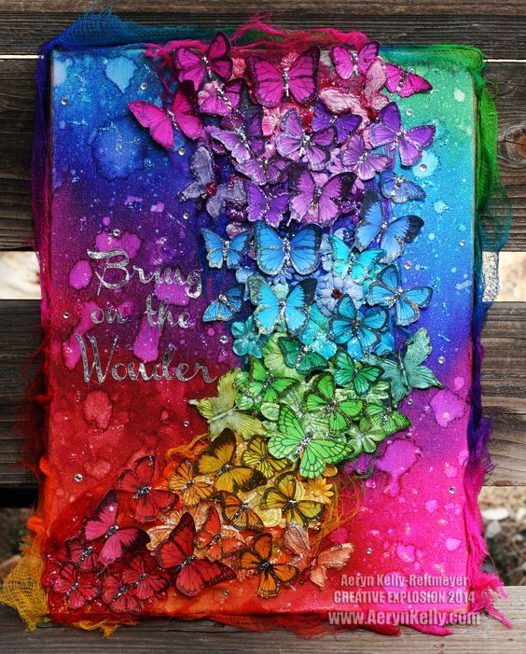
Mixed Media Project Examples

Slide 8
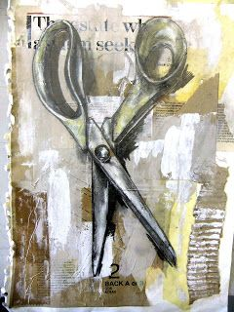
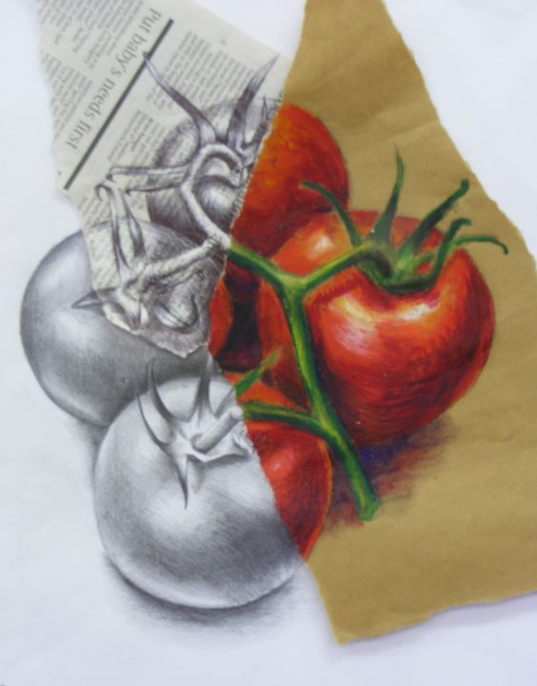
Mixed Media Project Examples

Slide 9
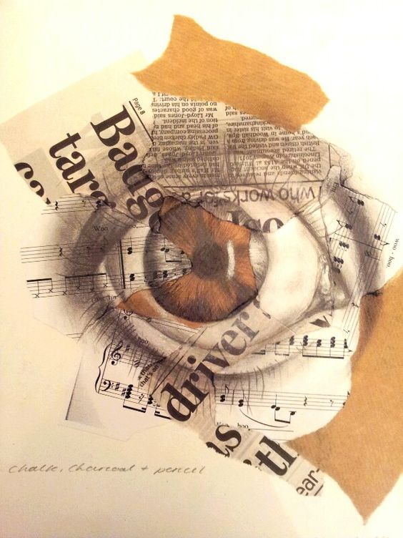
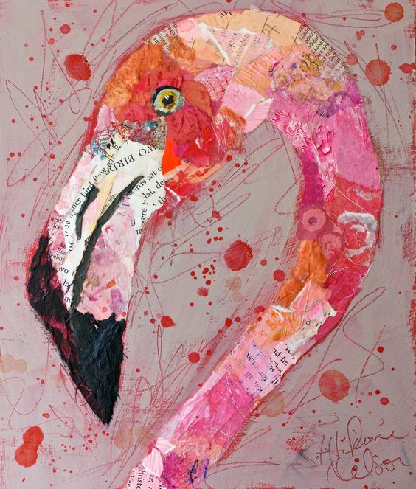
Mixed Media Project Examples

Slide 10
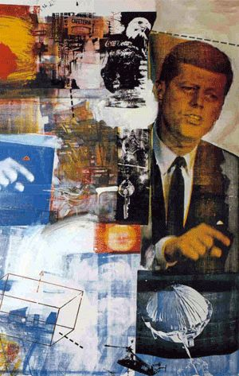
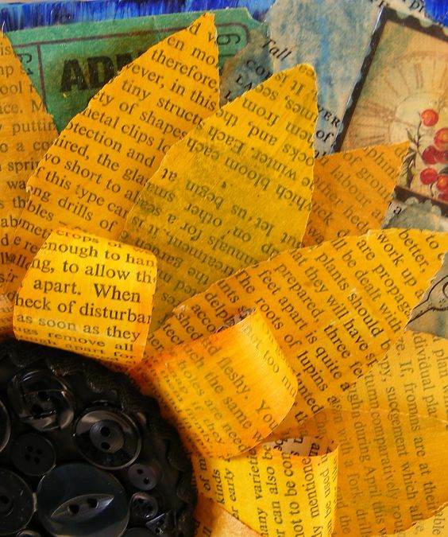
Mixed Media Project Examples

