Slide 1
Dias de los Muertos Unit: Sugar Skulls (Calaveras)
Beginning Art with Ms. Gay
Fall 2016

Slide 2
Dias de los Muertos: History
Dias de los Muertos (Days of the Dead) is an ancient celebration of those who have passed away.
The whole point is to celebrate, not mourn, passed loved ones.
In ancient beliefs, the souls of those who have passed continue on to the afterlife, and during this time those souls can “return” to the Earth to celebrate with their loved ones.
Originally celebrated by the Aztecs in Mexico, then shifted once Spaniards conquered area and tried to bring in Catholicism
Holiday lasted about a month originally, but then changed to the two days that it is observed now: November 1st and 2nd
Nov. 1st is for celebrating children who have passed (Dia de los Angelitos)
Nov. 2nd is for adults who have passed (Dia de los Difuntos)

Slide 3
Dias de los Muertos: Traditions & Symbolism
Traditions differ depending on the country, town, community, etc.
In Mexico, it is common to clean and decorate graves, or to create altars and ofrendas (offerings) for passed loved ones.
Common traditional elements of Dias de los Muertos:
Calaveras (sugar skulls): symbol of death and rebirth (afterlife); typically has the name of the recipient on the forehead (is often offered to the deceased and given as a gift to the living)
Altars/Ofrendas (offerings): set up to honor the deceased. They often have things that the deceased loved, such as food, pastimes, etc.
Marigolds: a flower that is also a symbol of death
Papel picado: elaborately cut paper decorations to honor the deceased
Catrina/Catrin: the Catrina is the Spanish adaptation of the Aztec Goddess Mictecacihuatl. Has socioeconomical symbolism in that it represents class divides.

Slide 4
Tucson’s All Souls Procession
We have our own unique procession, which is a march of people celebrating those who have passed on.
People wear costumes, play instruments, carry things for their loved ones, etc.
Following the Procession is the “Grand Finale” which includes performances and the burning of the urn, which is filled with people’s prayers for passed loved ones.

Slide 5
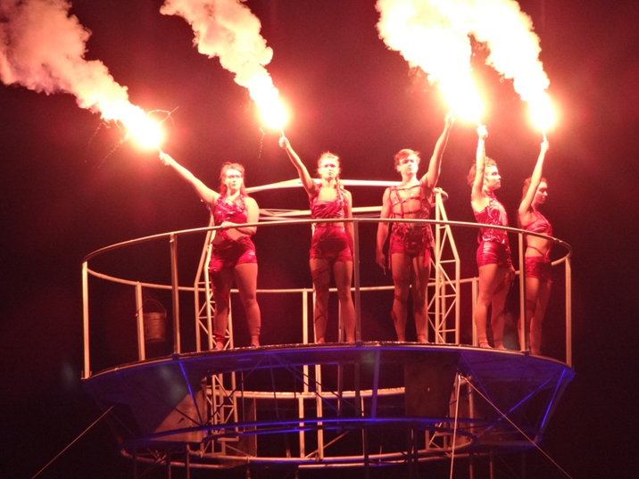
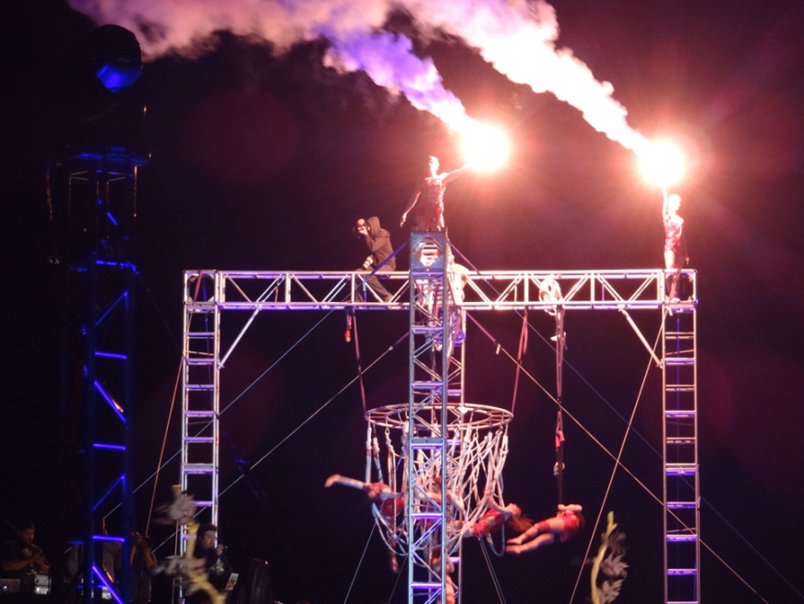
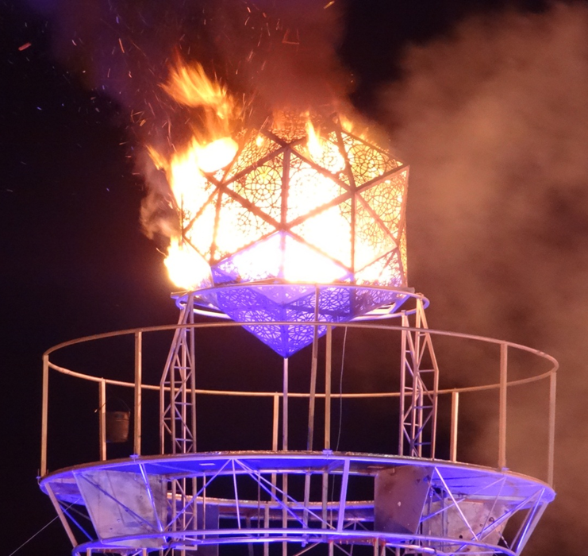
Tucson’s All Souls Procession

Slide 6
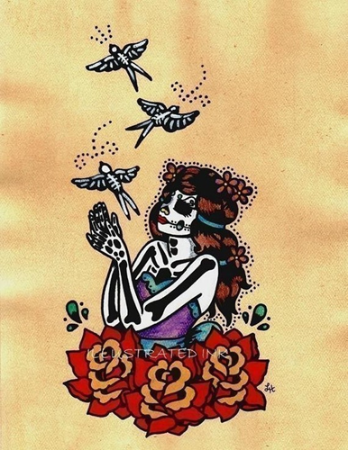
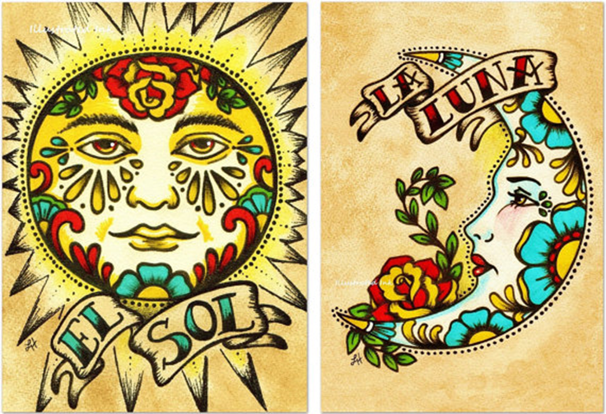
Some awesome artists who work in a Dias de los Muertos art style
Leila Cothran

Slide 7
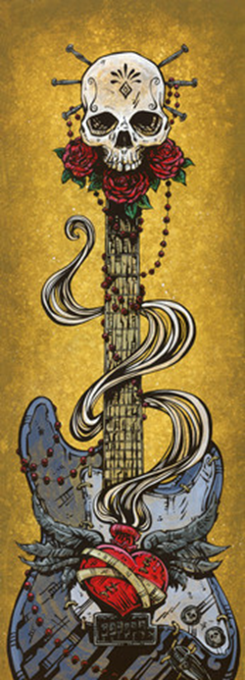
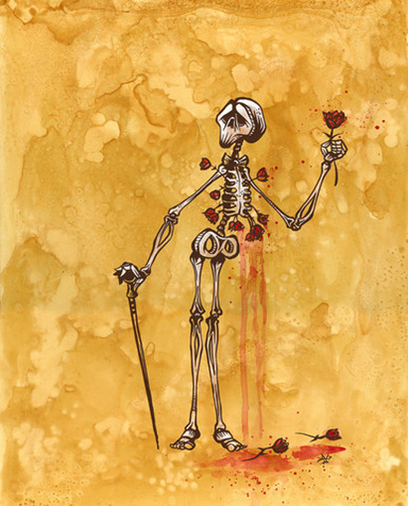
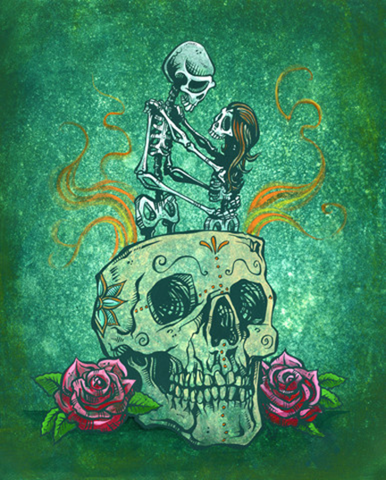
Some awesome artists who work in a Dias de los Muertos art style
David Lozeau

Slide 8
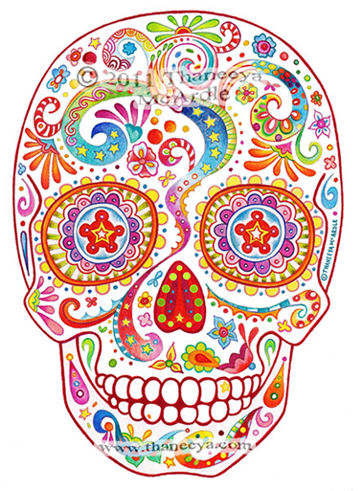
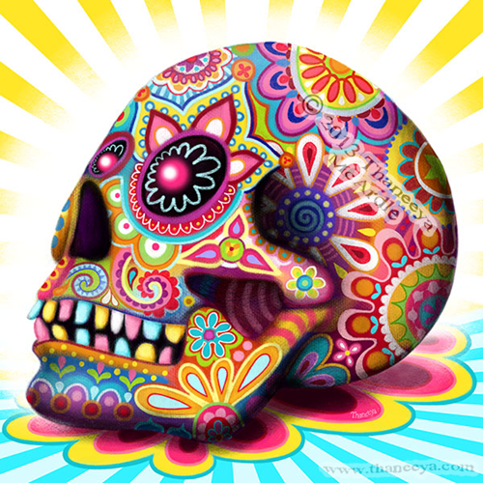
Some awesome artists who work in a Dias de los Muertos art style
Thaneeya McArdle

Slide 9
Your unit project: Make your own Sugar Skull (Calavera)
You will design and construct your own sugar skull using sugar and royal icing.
You will need to plan out your design by drawing in your sketchbook.
You will need to come up with two unique ideas.
We will be collecting supplies all throughout this week to prepare to make sugar skulls.
Please have your supplies turned in by Thursday of this week!
You will need to make two: one for practice and one to submit as a final for your grade.

Slide 10
Unit Schedule
Week 1: Bring in supplies all this week!
Monday, 10/17/16 | Project intro, skull drawing tutorial; begin planning
Tuesday, 10/18/16 | Work on project planning
Wednesday, 10/19/16 | PSAT/SAT Testing Day, super short classes; work on planning
Thursday, 10/20/16 | Work on planning, you should show your final plans to me by the end of the period in order to begin work on Monday.
Friday, 10/21/16 | Genius Hour
Week 2
Monday, 10/24/16 | Construct skulls out of sugar, let dry over night
Tuesday, 10/25/16 | Begin decorating with royal icing
Wednesday, 10/26/16 | Decorate skulls
Thursday, 10/27/16 | Class critique of finished skulls
Friday, 10/28/16 | Genius Hour

Slide 11
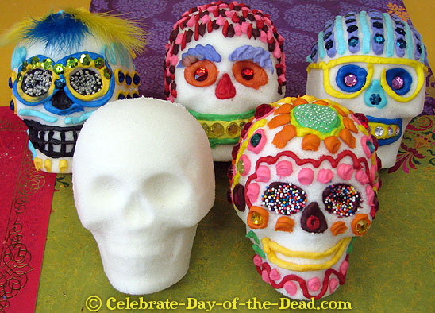
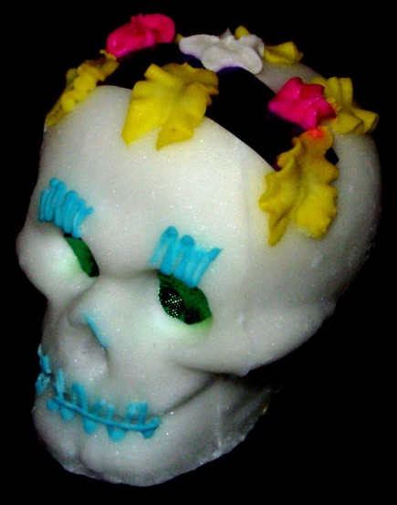
Sugar Skull Examples

Slide 12
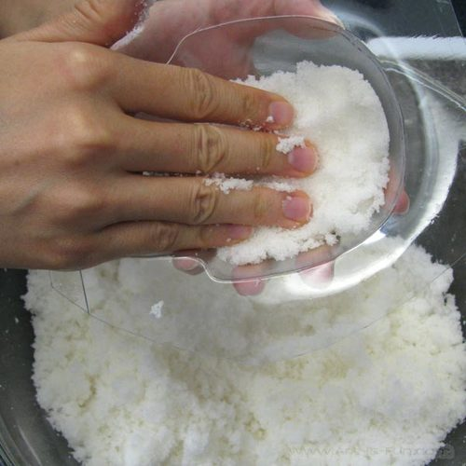
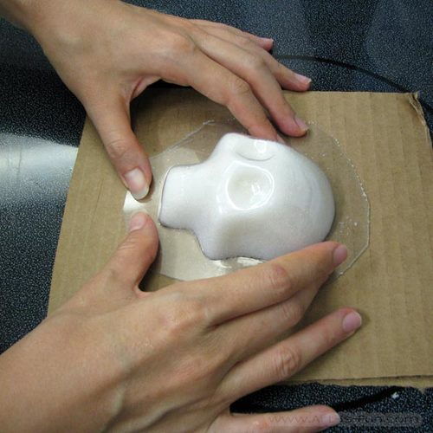
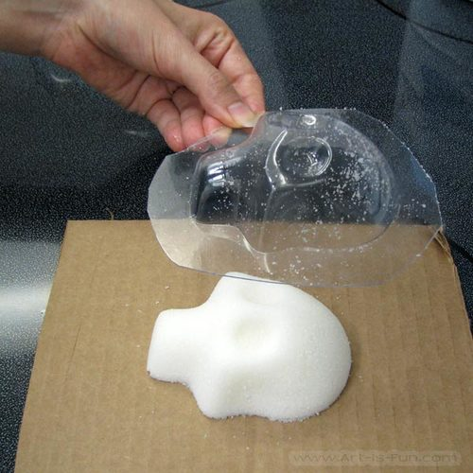
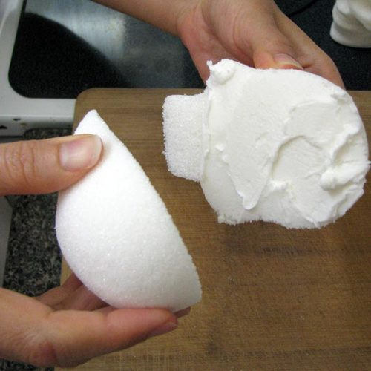
How to Make a Sugar Skull
Make “sugar paste” (sugar + meringue powder + water), place into sugar skull mold; mold front and back pieces
Sugar skull needs to dry out overnight
Mix royal icing (powdered sugar + icing + color) and use to adhere front and back pieces, then use to decorate

Slide 13
Focus on getting these supplies for your class
Plastic bowls with lids (tupperware, it will be returned) to store royal icing as we will use it over a two day period (large size preferred)
Icing colors, in colors black and red, preferably by Wilton; this is NOT food coloring/dye.
Sprinkles, glitter, feathers, etc. for decorating

Slide 14
Needed Supplies for this Project
White granulated sugar (4 pound bags are $2.00 at Walmart, or 10lb. bag at Costco for $4.39. We will need about 80 lbs. of sugar to have enough for all students to make ONE sugar skull!)
White powdered (or "confectioner's") sugar for making royal icing, will also need a LOT
Meringue powder, which can be ordered online or found in specialty cooking/baking stores (such as Pat’s here in Tucson)
Icing colors, preferably by Wilton; this is NOT food coloring/dye. Check online.
Frosting to use for decorating, preferably in tubes that would be easy to handle for students
Other decorative items, such as glitter, sprinkles, etc.
Plastic ziploc or icing bags for decorating
Icing tips to use with icing bags
Disposable plastic bowls for mixing sugar and frosting (medium to large size, can be found next to plastic cups/utensils)
Plastic bowls with lids (tupperware, it will be returned) to store royal icing as we will use it over a two day period (large size preferred)
Sugar skull molds, which can be ordered online. These will also be returned upon the end of the project.

Slide 15
Sketchbook Assignment #4
Create an image based on one of the symbols of Dias de los Muertos that we discussed in class: Calaveras, altars, ofrendas, marigolds, or Catrina/Catrin
Make sure to draw large to fill the page.
Every sketchbook assignment you complete should look like an hour of effort.
SB #4 is due on Thursday, October 27th at the beginning of the class period.

