Slide 2
Welcome back! …notice anything different about the room?
Art with Ms. Gay, room 300
Monday, October 19th, 2015

Slide 3
Agenda for Monday, October 19th, 2015
Classroom expectations trivia
Back to basics: reviewing the general shapes method
Remember that thing called a sketchbook? You’re going to need it today.

Slide 4
Before we start the trivia…
I have made a couple of adjustments for the new quarter:
Point Bank: everyone will start out the quarter with 25 EXTRA CREDIT POINTS. This can give you an extra boost at the end of the semester when “burn out” hits.
HOWEVER, every time you don’t follow one of our classroom expectations I will deduct points from your point bank.

Slide 5
Point Bank
Point deductions:
Cleaning up and standing by the door before it’s time to actually clean up: 2 points for the first offense; doubles every time it happens after that (ex: 4 points the second time, 8 points the third time…)
EATING IN CLASS: 5 points first offense, in addition to the standard consequences (including phone call home)
Not cleaning up after yourself (we always know): 10 points
Whole class: points will be deducted if there is a sub and your class gets a “bad note.”
As things come up, we will discuss them as a group and decide an appropriate point deduction OR earned points back into the bank.

Slide 6
Alright, let’s start the trivia!
(An opportunity to earn EXTRA POINTS for your point bank)

Slide 7
With some exceptions, which day of the week is the unit project and sketchbook assignment due?

Slide 8
Answer: on Thursdays

Slide 9
What is Genius Hour?

Slide 10
Answer: the hour used each Friday for students to work on self-designed art projects throughout the semester.

Slide 11
How much is deducted from your grade when an assignment is turned in late?

Slide 12
Answer: 10% for each day it is late

Slide 13
What is the policy on eating in the classroom?

Slide 14
Answer: NO EATING. If you’re starving, go out in the hall and eat quickly and then rejoin the class.

Slide 15
How can you earn extra credit?

Slide 16
Answer: creating one-page artworks in your sketchbook
(Other acceptable answers: answering these trivia questions; cleaning)

Slide 17
What will happen if art supplies are being misused?

Slide 18
Answer: they will be locked away so no one can use them

Slide 19
What is the first consequence for an individual student who is not following our classroom expectations?

Slide 20
Answer: verbal warning from the teacher

Slide 21
Briefly describe the clean up procedure for when we are using paint.

Slide 22
Answer: dump out water in the sink; clean brush in the sink; clean out paint palette; return all items to their original places.

Slide 23
What is the link for our class website?

Slide 24
Answer: artatsahuaro.weebly.com

Slide 25
What is TRUST?
(I will award 5 additional points if you can tell me what each letter stands for in the acronym)

Slide 26
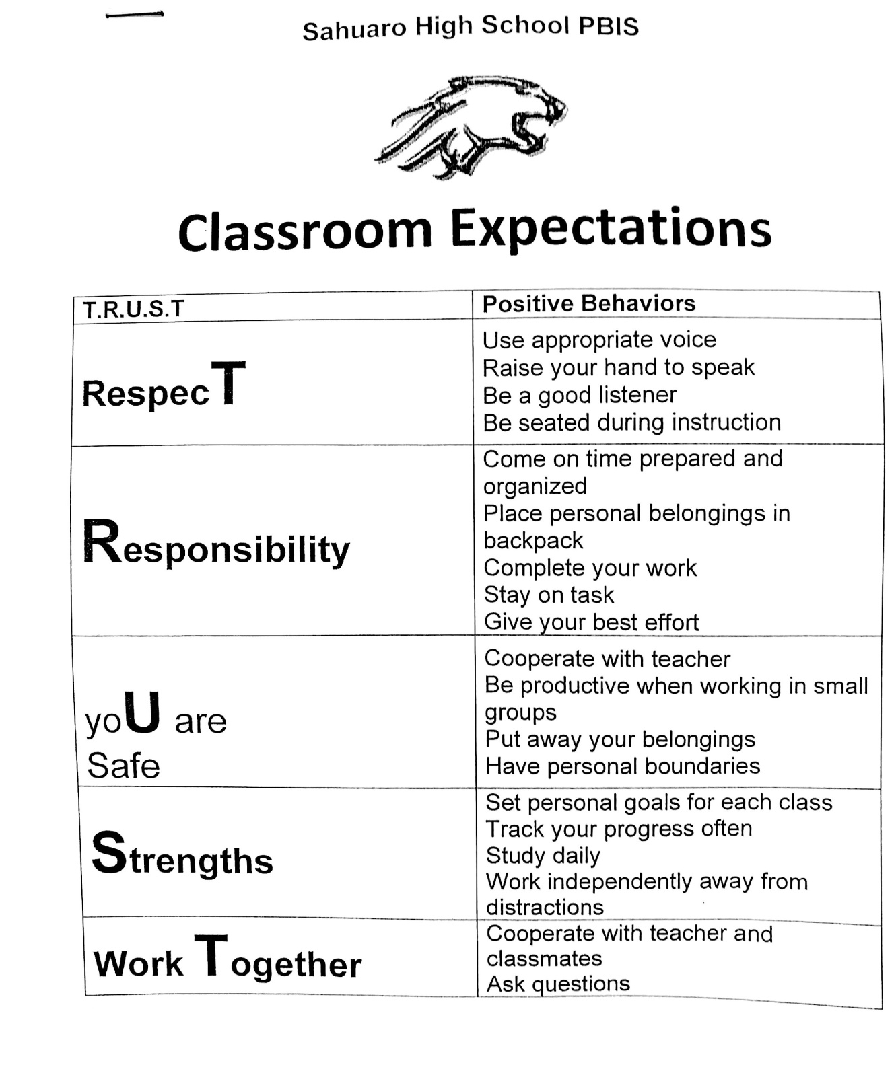
Answer: TRUST is the school-wide PBIS expectations for Sahuaro.

Slide 27
This Week
Due Thursday, October 22nd: sketchbook assignment and project
Sketchbook assignment #7: create a contour drawing—any subject matter. Must fill the whole page. Can use hatching/cross-hatching to shade, but otherwise no other methods may be used.
Project: cartoon drawing using the general shapes method. Will be reviewed using the fancy smart board in class. Check website for details.
Genius Hour on Friday, October 23rd: must have rough sketches of your project ideas ready to present (if you have not shown me already—some students have ALREADY FINISHED THEIR PROJECTS!). This is a graded check.
WHAT YOU NEED TO HAVE READY FOR TOMORROW: a cartoon reference image. You can use your phone, print one from the library, bring in a comic book…if you don’t have something, you will have to use one of my reference cartoons.

