Slide 1
Charcoal Drawing
Art with Ms. Gay
Fall 2016

Slide 2
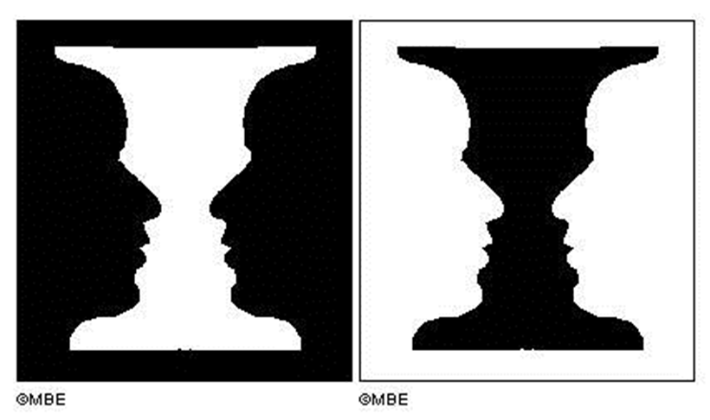
What do you see?

Slide 3
Charcoal Practice

Slide 5
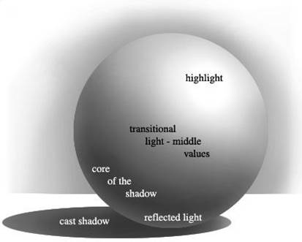
Charcoal Practice

Slide 6
Charcoal Practice

Slide 7
Charcoal Practice

Slide 8
Charcoal Practice

Slide 9
Charcoal Practice

Slide 10
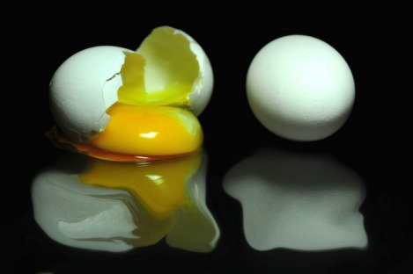
Charcoal Practice

Slide 11
Unit 7 Project: Origami Charcoal Drawings
For this project you will create a series of three charcoal drawings based on an origami sculpture that you create.
I will provide some simple origami tutorials that you can use for this project, or you can find your own (look online, use a book, etc.).
In planning for this project, observe your origami sculpture from different angles to find the best composition for each of your drawings. Draw a rough sketch of all 3 compositions in your sketchbook and show me for approval. This is how you will get your final paper.
All three drawings will need to be done on provided square paper and mounted on a larger paper to be considered complete.
For the three drawings you will need to create one of each:
One regular charcoal drawn on white paper
One regular charcoal drawn on brown butcher paper
One white charcoal drawn on black paper
The final project is due on Thursday, November 10th at the beginning of the period.

Slide 12
Sketchbook Assignment #5
Watch your favorite movie or TV show. Find a scene that exemplifies one of the rules of composition that we studied.
Draw the scene to fit your entire sketchbook page.
On the back, write which rule of composition your image is following.
This sketchbook assignment is due on Thursday, November 10th at the beginning of the period.
Remember, I gave you a half-sheet with all of your sketchbook assignments listed on it for this quarter. If you forget what you need to do, refer to this sheet.

