Slide 1
Careers in Art Last project for the semester! (Other than your Genius Hour Final)
Art with Ms. Gay
Spring 2016

Slide 2
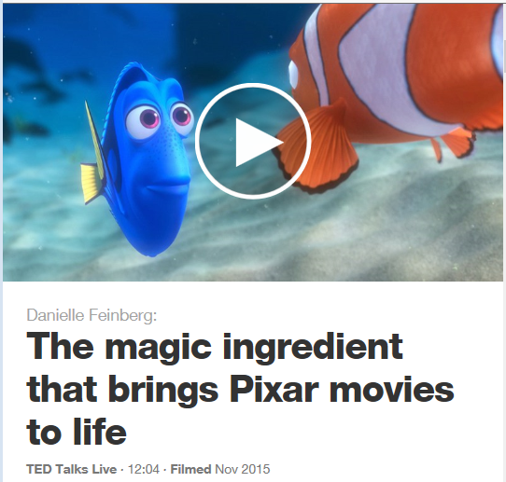

Slide 3
Careers in Art Unit Project
For this project, you will research a career you are interested in that is related to art.
You may work alone or in pairs. I will send around a sheet for you to tell me which career you have chosen to research and who you will be working with. YOU CANNOT RESEARCH THE SAME CAREER AS ANOTHER GROUP.
Project Requirements:
Assemble a PowerPoint with info about your career and present it to the class
Create a visual aide that tells the viewer about your career

Slide 4
Project Requirements
You must include the following in your PowerPoint:
What people in your chosen career actually do
Education & any relevant experience needed for your chosen career
How art is used/helps prepare people for that career
Find someone notable in the career field and include some info about them: audio clip, short video, magazine interview
You can create at least one of the following visual aides that “recruits” people, intended to complement your presentation:
Brochure
Magazine Advertisement
Poster
Booklet
Come up with something else I haven’t listed here that is creative…clear it with me before you start though

Slide 5
Ideas for careers in art that you can research
Animator
Studio Artist
Photographer
Sculptor
Graphic Designer
Fashion Designer
Tattoo Artist
Cinematographer
Comic Book Artist
Caricaturist
Interior Designer
Make-up Artist
Set Designer
Art Educator
Art Curator
Video Game Designer
Software Developer
Art Therapist
Architect
Illustrator

Slide 6
Unit Agenda
Monday, May 9th | Careers in Art Project Intro; choose career to research and begin work
Tuesday, May 10th & Wednesday, May 11th | Work in computer lab on presentations (meet in classroom for attendance first)
Thursday, May 12th | In-class work; can go to library (with pass) to continue working on presentation or work on visual aide in classroom
Friday, May 13th | Genius Hour
Monday, May 16th & Tuesday, May 17th | Work day on projects
Wednesday, May 18th & Thursday, May 19th | Project presentations/senior Genius Hour presentations (if want to present final early; otherwise will have final on Monday, May 23rd [1st period] or Tuesday, May 24th [2nd period])

