Slide 1
Unit 2: Vans Custom Culture Contest 2016
Art with Ms. Gay
Spring 2016

Slide 2
Vans Custom Culture Contest: What is it?
The shoe company Vans offers a national contest for public high schools that gives students the opportunity to design four pairs of Vans.
We are one of 3,000 schools across the country competing for the grand prize: $50,000 for our art program here at Sahuaro!
Finalists get to travel for judging and have a special opportunity to enter another contest to design a skateboard deck.
For seniors/maybe juniors: student finalists are offered a scholarship to an art school in CA!

Slide 3
How will this work?
With only four pairs of shoes to enter into the contest, they have to be AMAZING. We have to design the shoes according to four themes:
Art
Music
Action Sports (only “board or bike”, not “ball or stick” is how Vans defined this)
“Local Flavor”

Slide 4
How will this work?
First, you will create plans for your designs. You need to have at least three unique designs (can all be done on one style of shoe or use a different style for each idea).
You will submit a final design based on your ideas that shows all sides of the shoes. I have templates to give you that you can use to start with, but you will still need to draw the other sides that are not shown.
Every student will turn in their final designs as a project grade. I will compile all of the designs into a photo slideshow and there will be a class voting session to narrow down the top designs.
After all classes have voted, we will have a final round of voting that represents all of the final designs from all classes. You will vote on the final designs/artists that will become our shoes.
The finalist artists will form a committee and be responsible for executing the designs. This will be a collaborative effort between many students, not just a few.

Slide 5
Contest Timeline
Week of February 1st-5th and February 8th-12th: work on designs (final design = unit project grade!) Final designs due on Thursday, February 11th.
Week of February 15th: class voting sessions; first round for each class will be on Monday, February 15th; final voting session will be on Tuesday, February 16th based on class results.
Week of February 22nd: shoes should be arriving on campus! Shoe design committees will be formed based on votes and student commitment.
Week of February 29th: Student committees will begin their work on the shoes! Shoes must be completed before spring break: last day to work will be Thursday, March 17th.

Slide 6
Contest Rules
Each pair of shoes must follow one of the provided themes: art, music, action sports, and “local flavor.” For your final design, you should choose to focus on one theme and shoe design.
Shoes do not have to be wearable—here is where to get creative! You can add things to the shoes—make them into sculptures, add fabric, use different media, etc.
You CANNOT copy or reproduce any copyrighted image or text. Do not include celebrity names, company logos, etc. All artwork in the final designs MUST be completely original.
We have to be careful about following the guidelines. If one pair of shoes doesn’t follow the guidelines set by Vans, we will be eliminated from the entire contest.

Slide 7
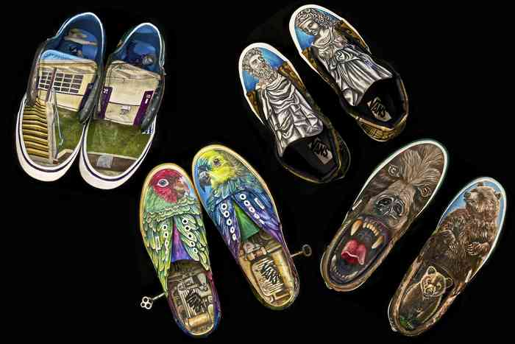
Past Finalist Submissions

Slide 8
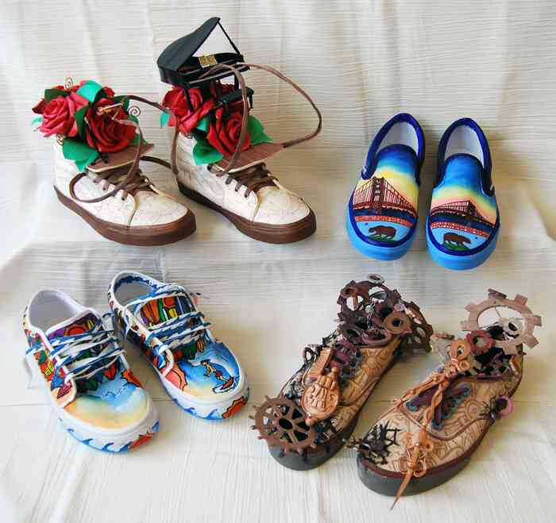
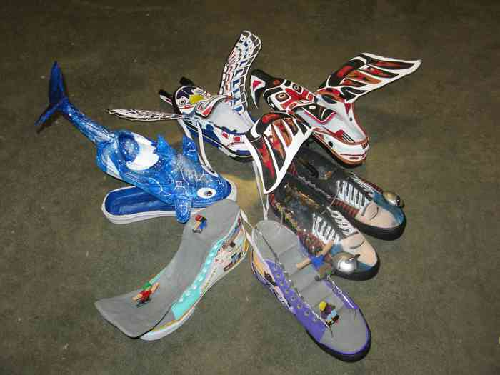
Past Finalist Submissions

Slide 9
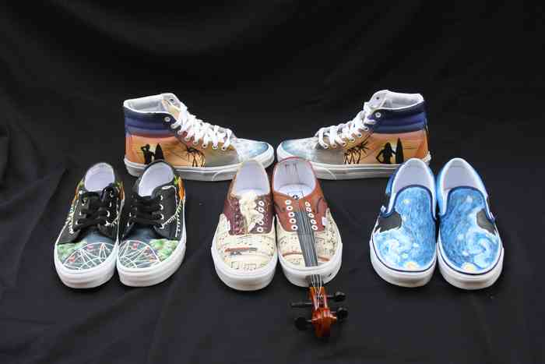
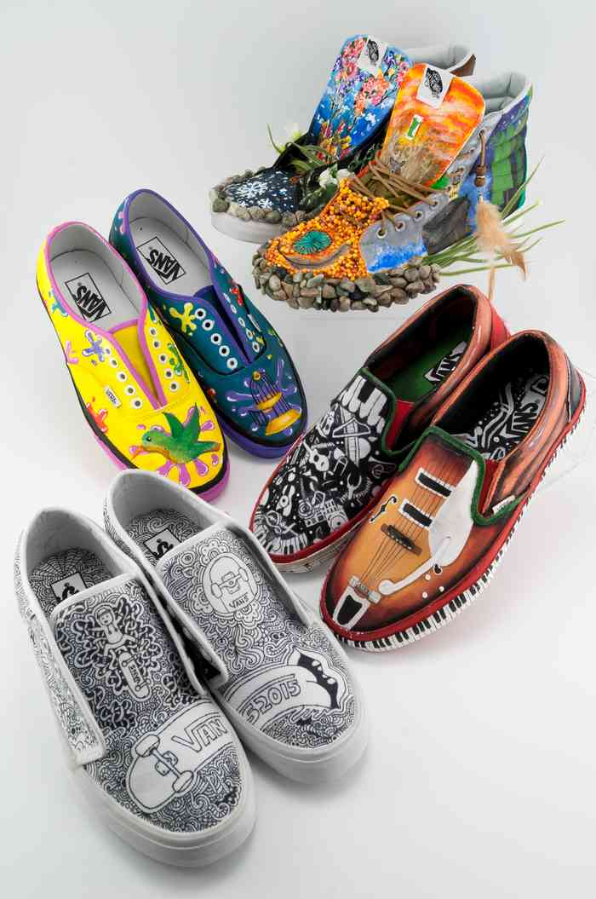
Past Finalist Submissions

Slide 10
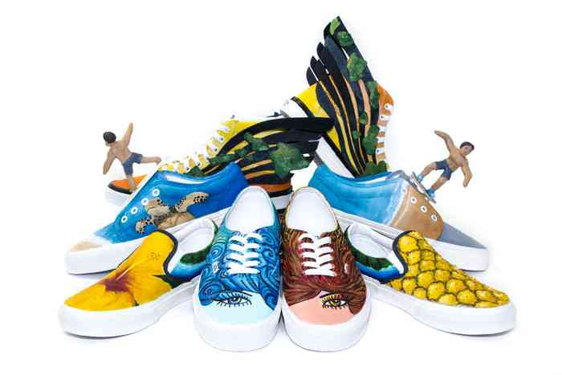
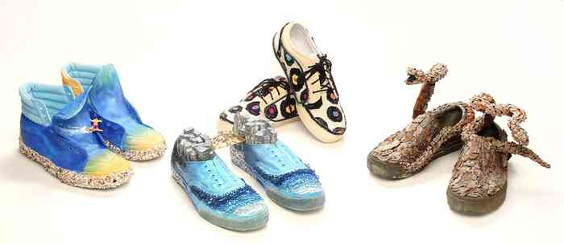
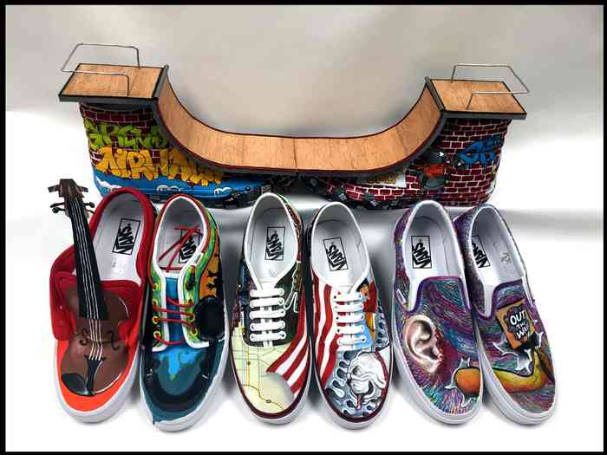
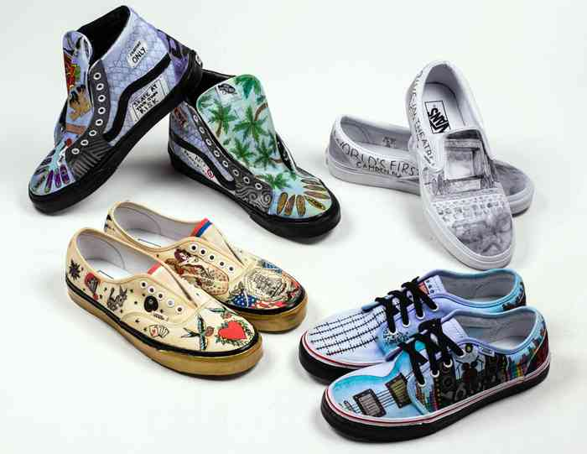

Slide 11
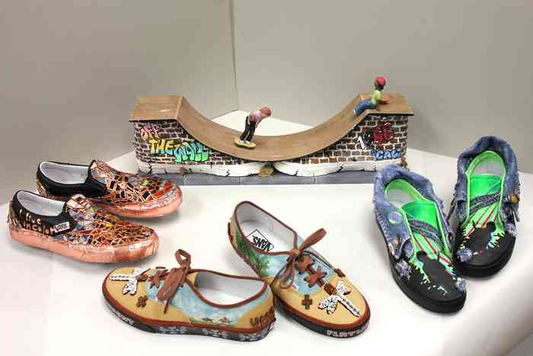
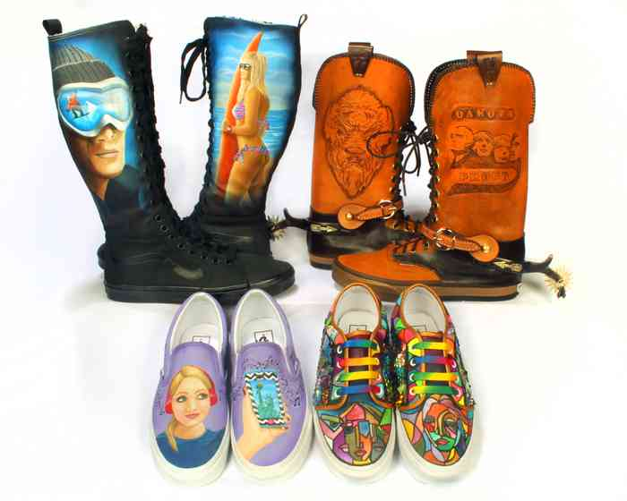
Past Finalist Submissions

Slide 12
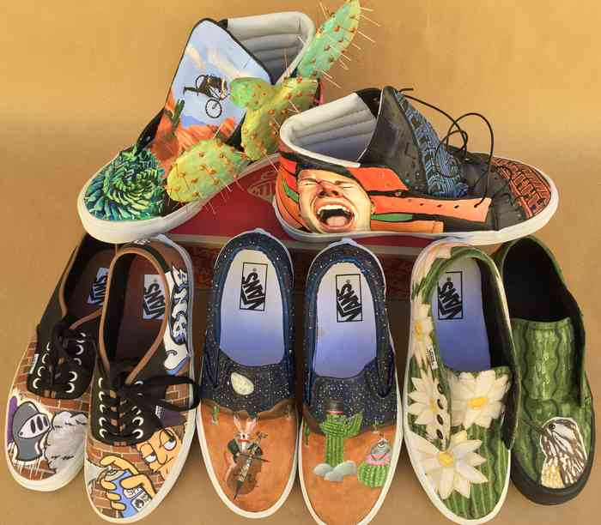
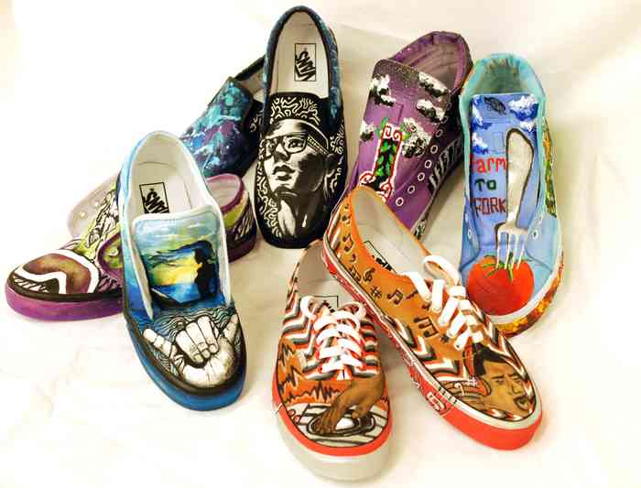
Past Finalist Submissions

Slide 13
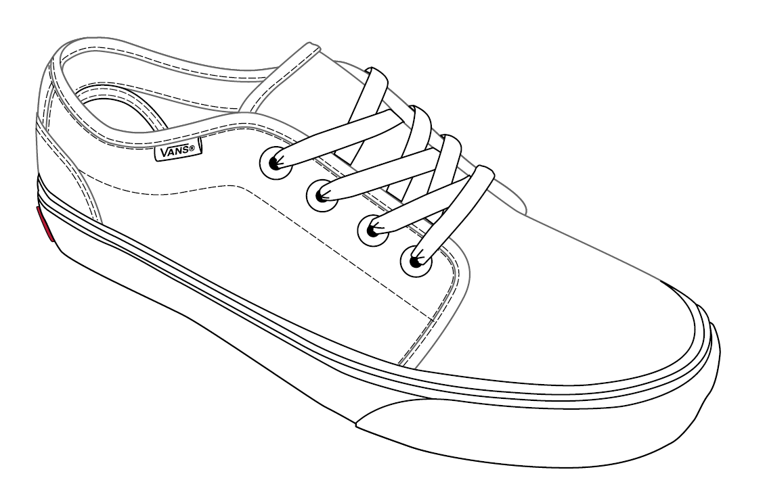

Slide 14
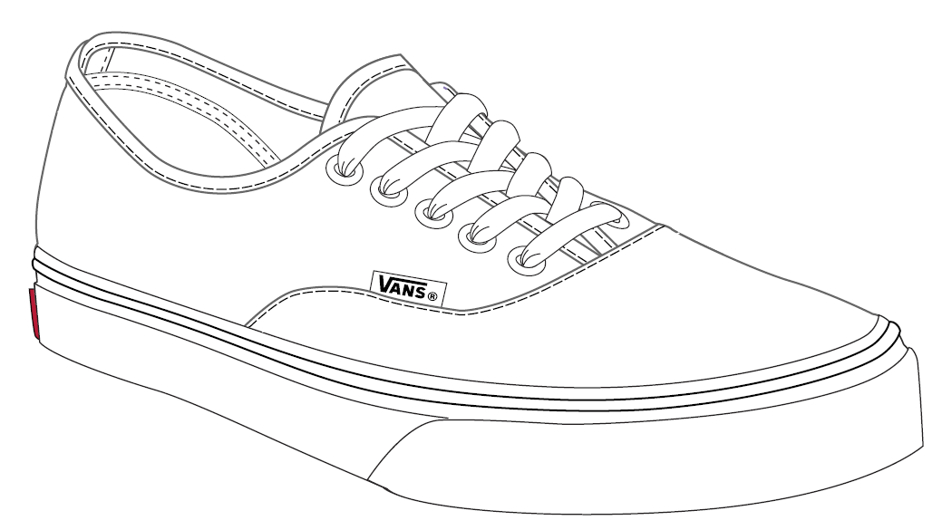

Slide 15
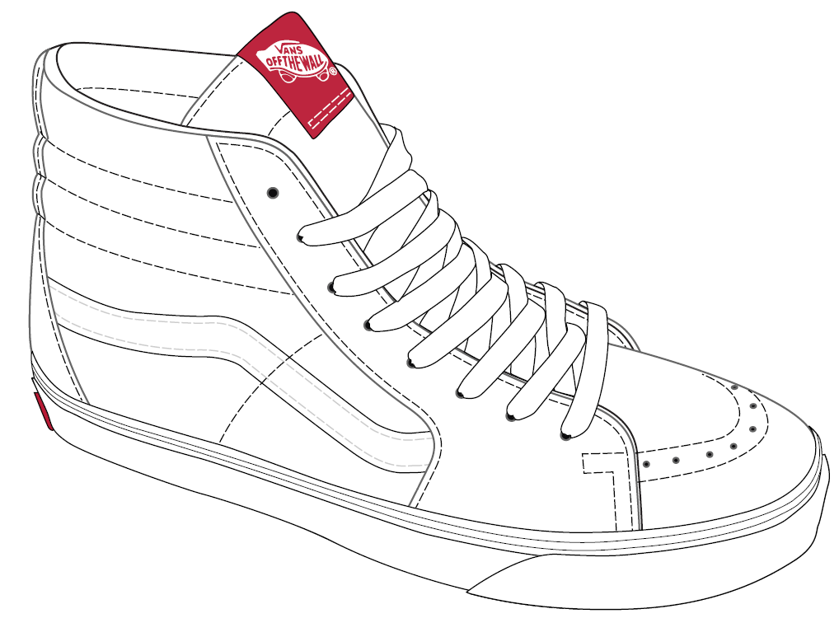

Slide 16
